Slide 1
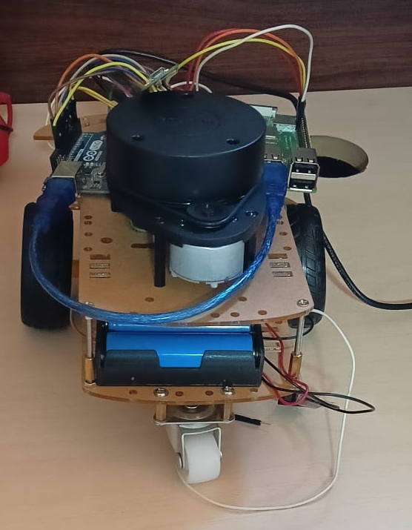
Autonomous vehicle setup
Mariam Hussien

Slide 2
Agenda
Testing motors with Arduino
Testing motors with ROSserial
Testing IMU with Arduino
Setting IMU package on raspberry pi
Testing encoder
Encoder code for publishing
Testing lidar

Slide 3
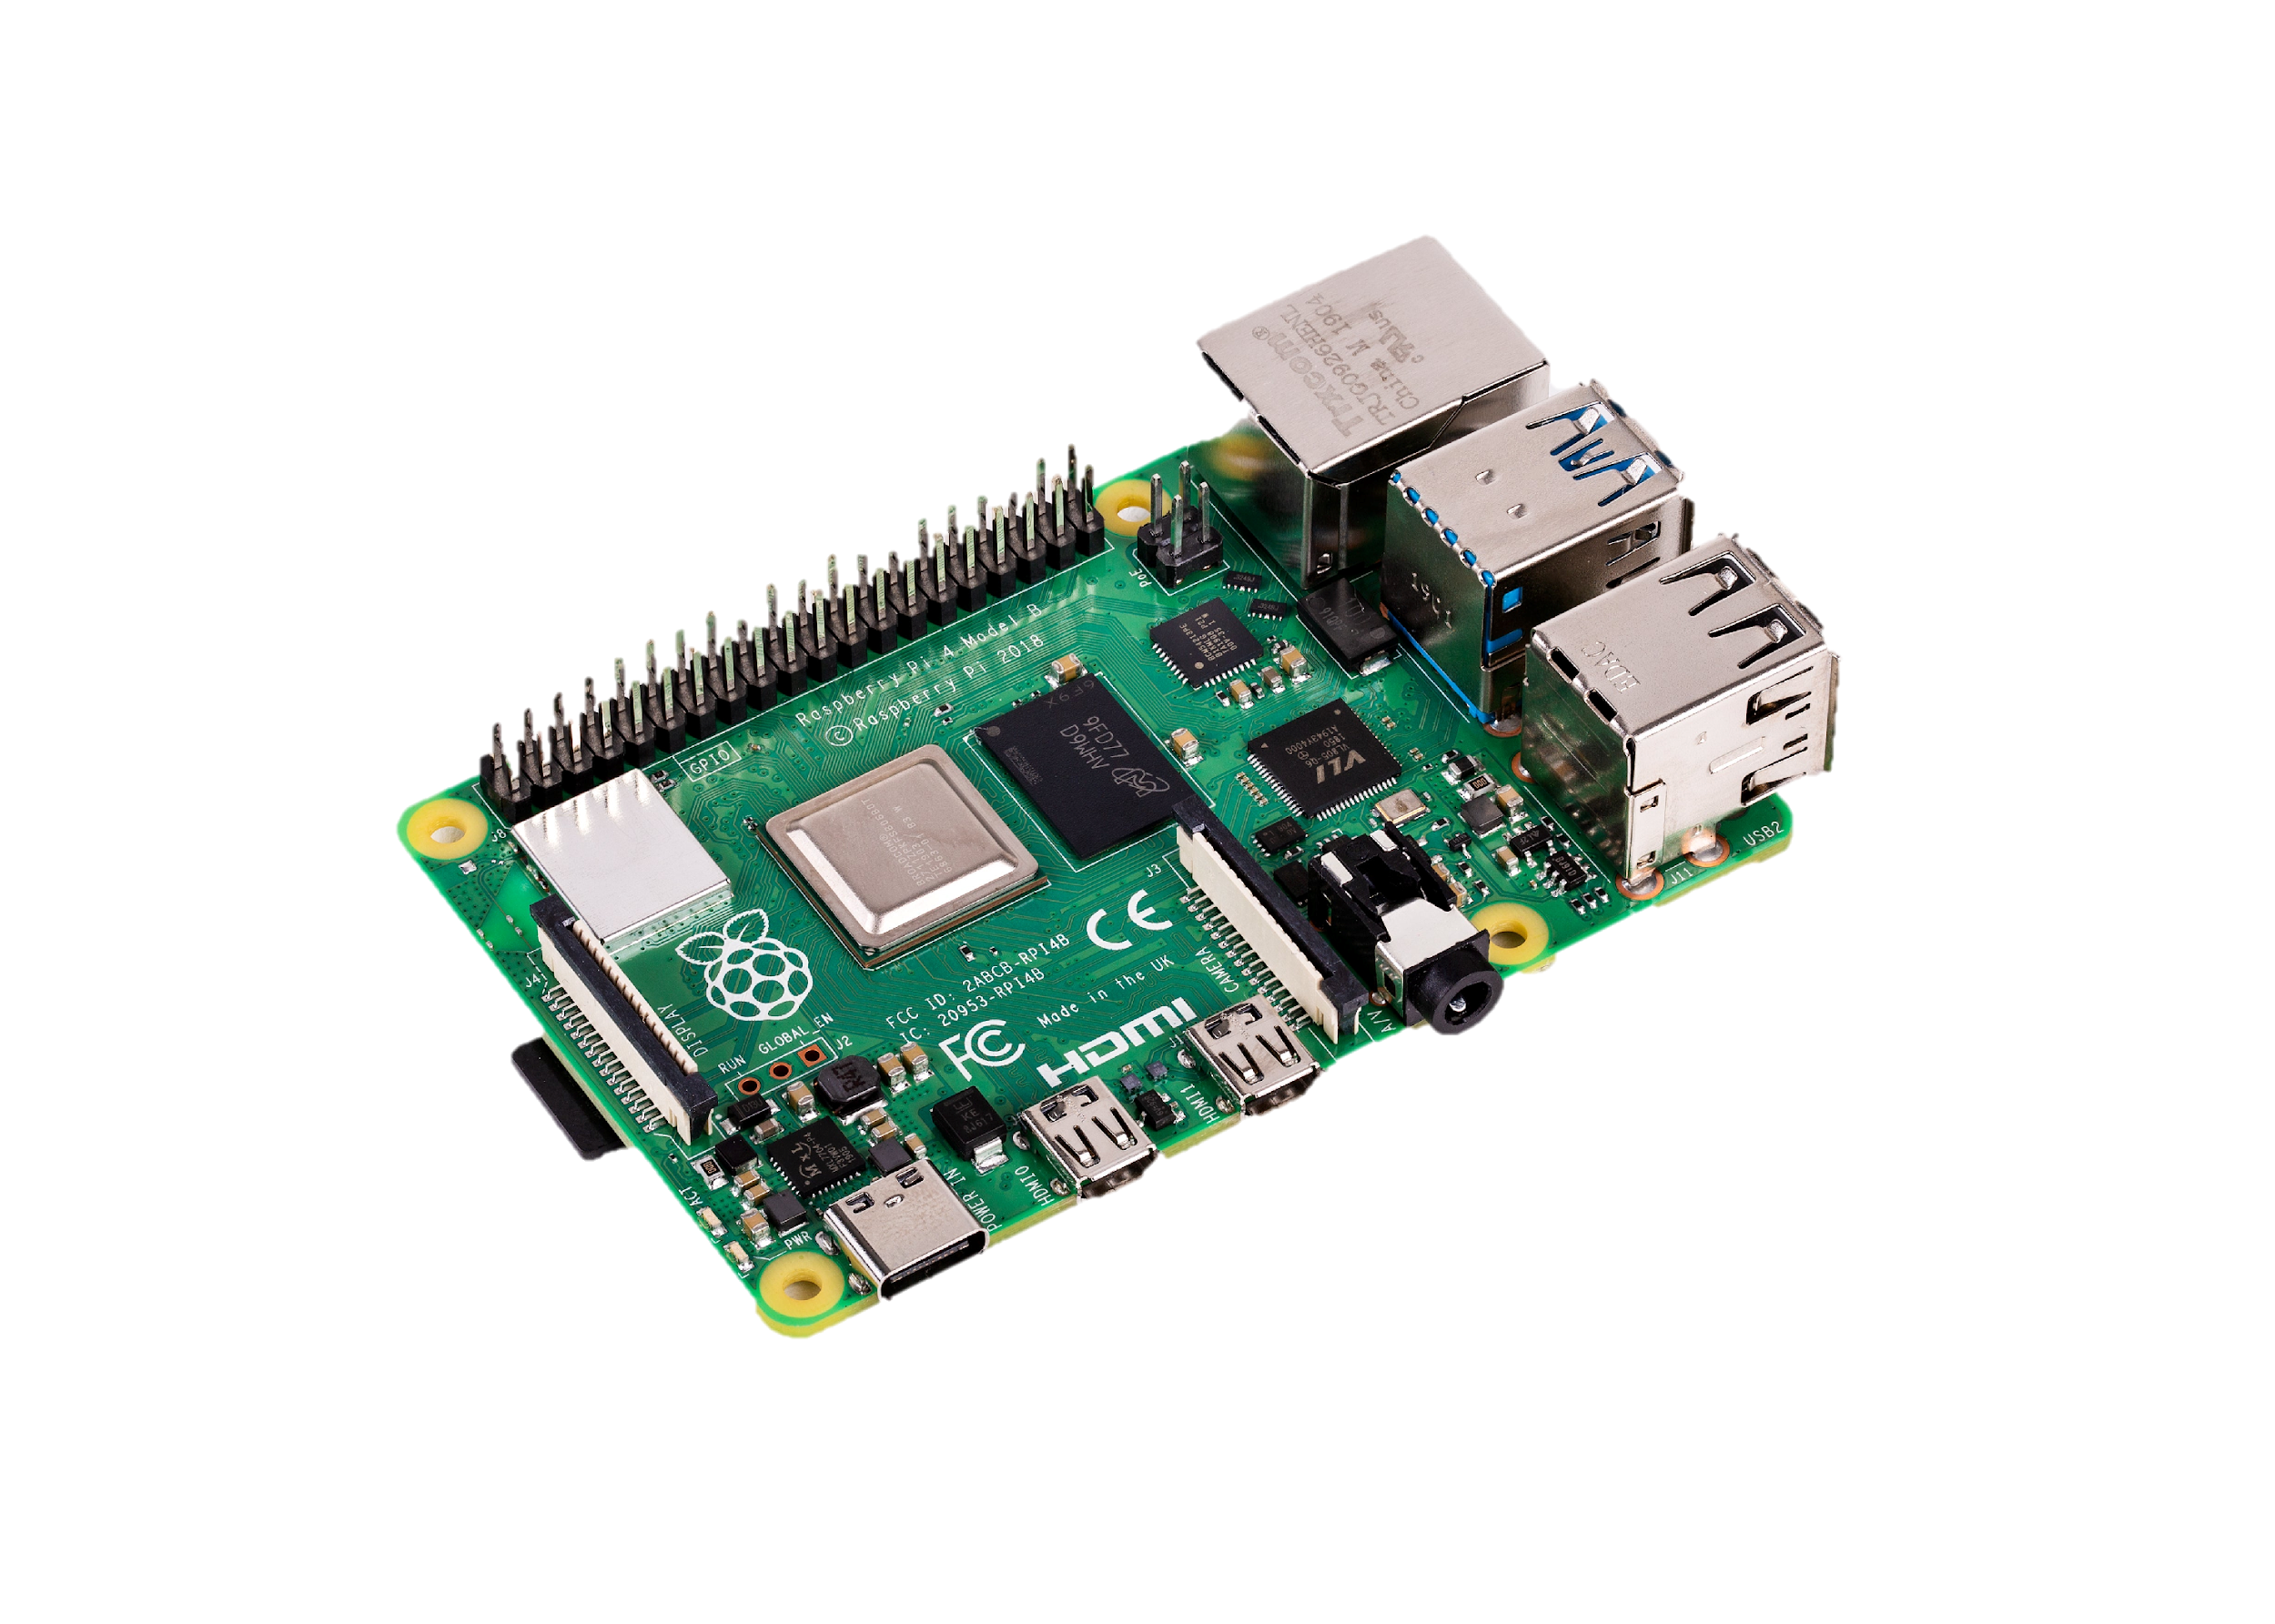
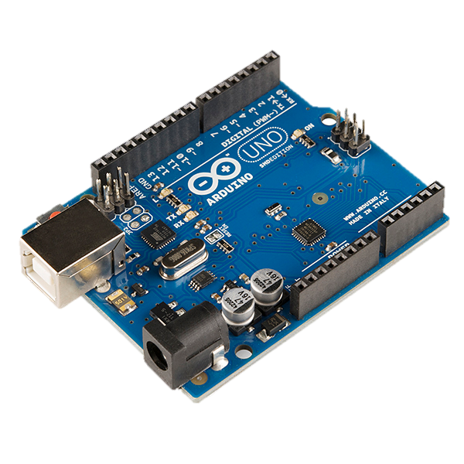
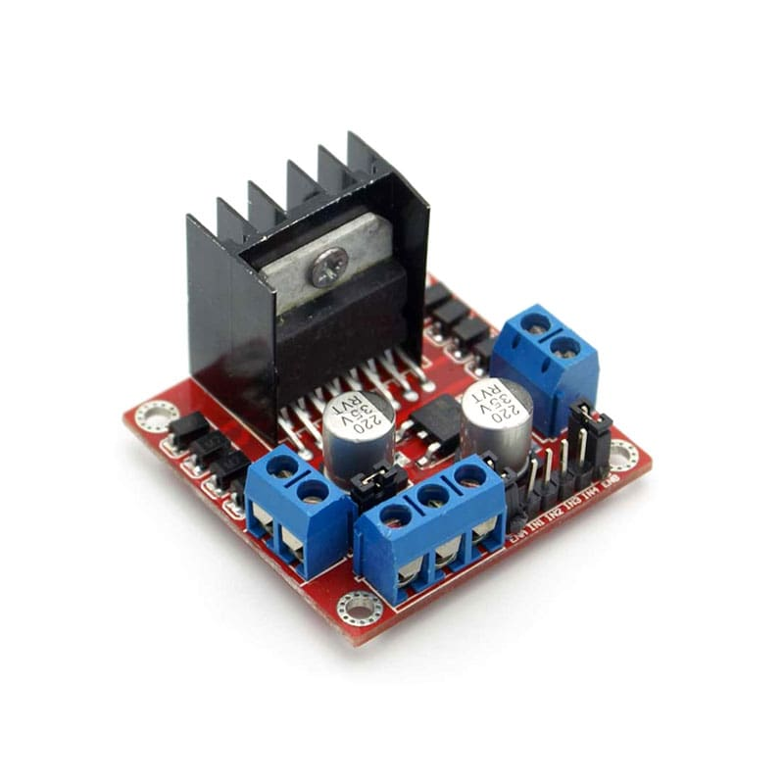
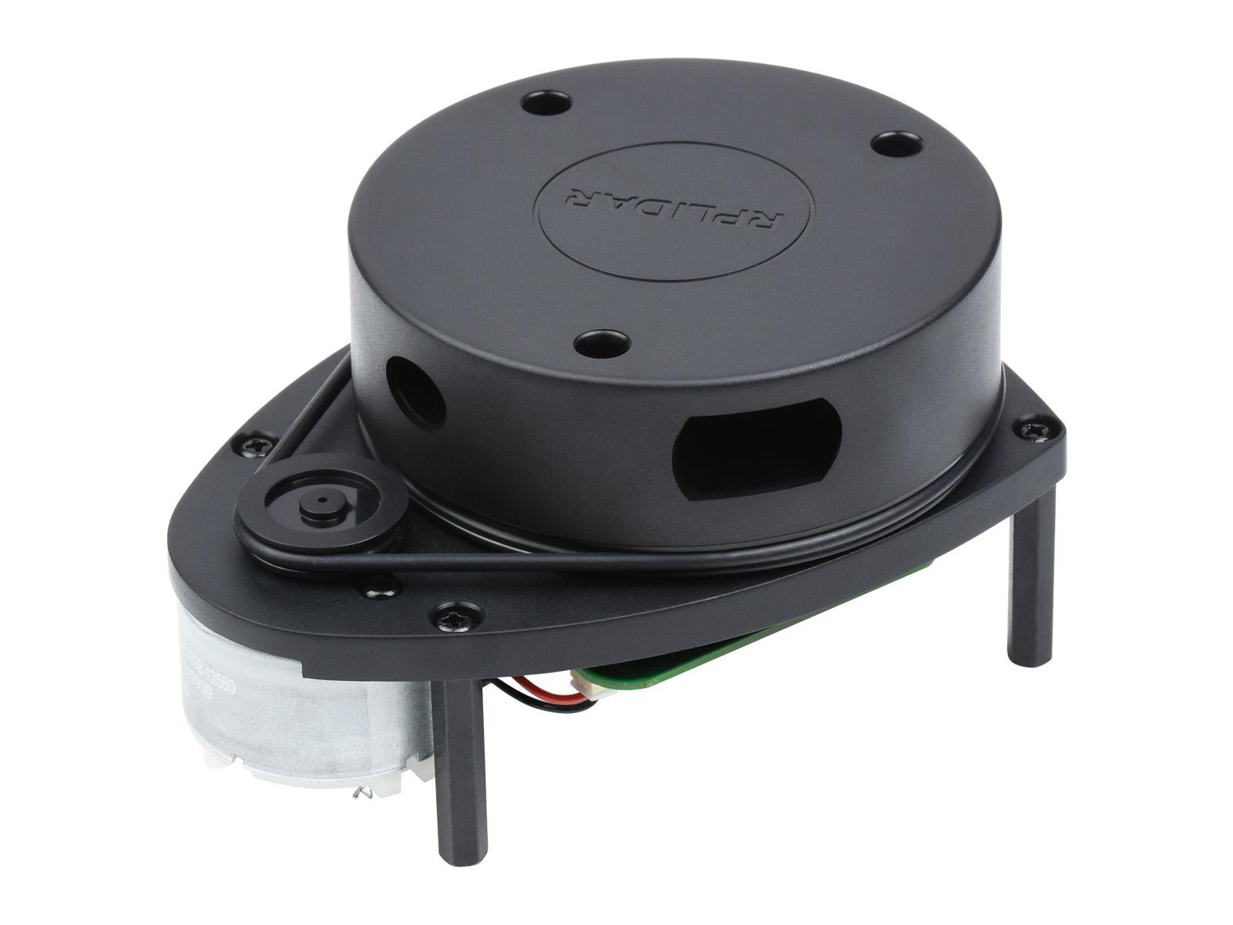
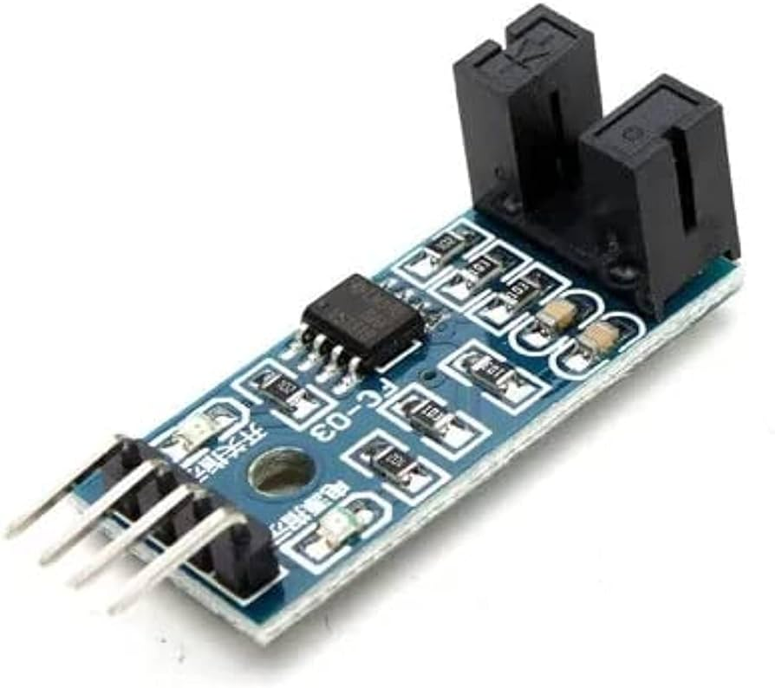
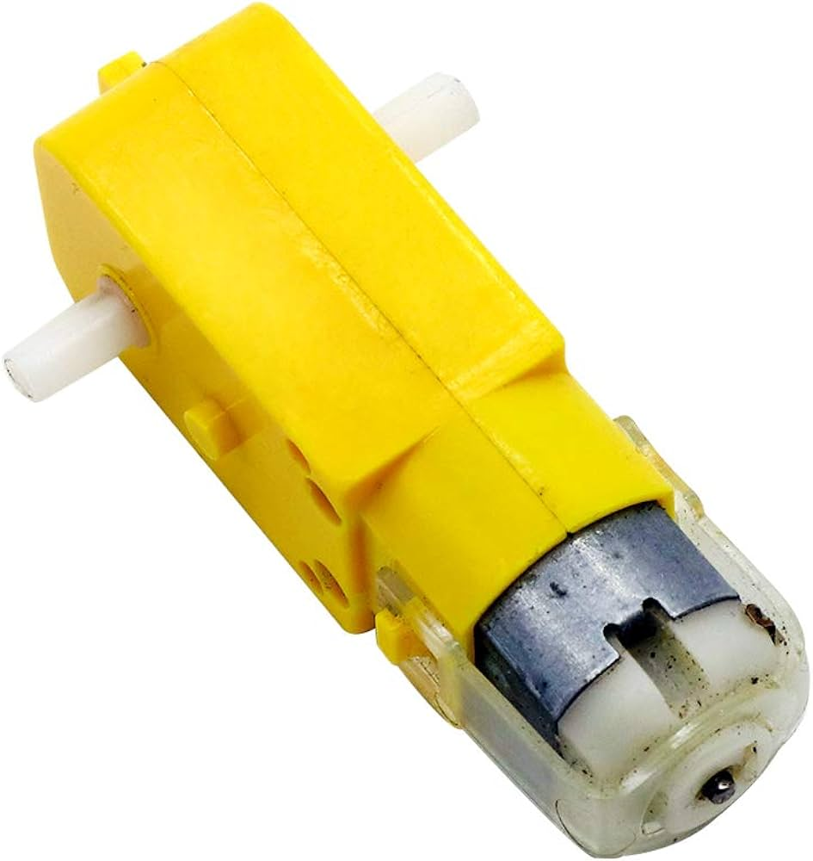
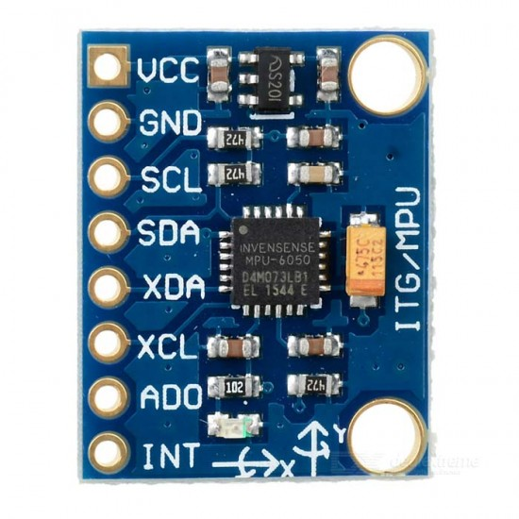
Components

Slide 4
Install ubuntu server on raspberry pi
https://ubuntu.com/tutorials/how-to-install-ubuntu-on-your-raspberry-pi#1-overview
Note: roboticscorner raspberry pi
Username: roboticscorner
Password: roboticscorner
IP: 198.168.1.49

Slide 5
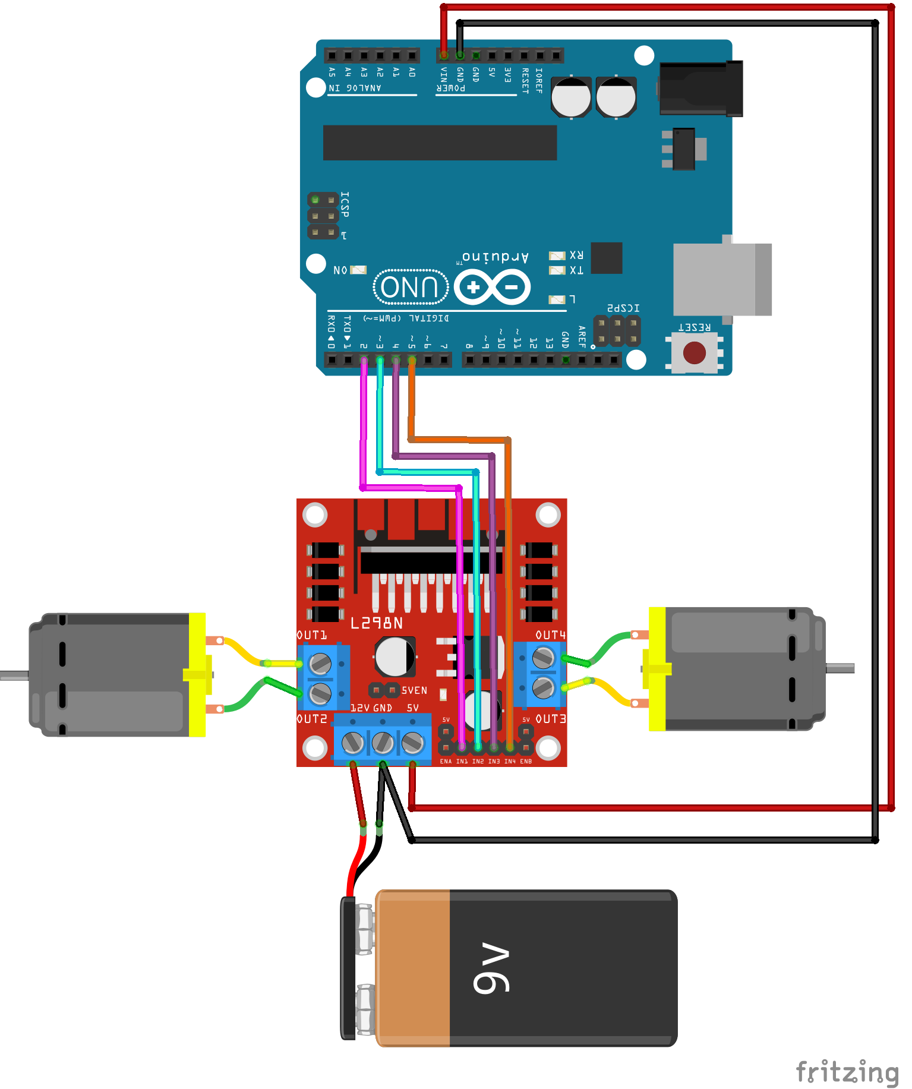
Motors
We are using L298 motor driver
It has 2 pins for each motor and 1 pin to control speed
We will first test it with Arduino and drive forward and backward
Then we will use ROSserial and control the motors through cmd_vel

Slide 6
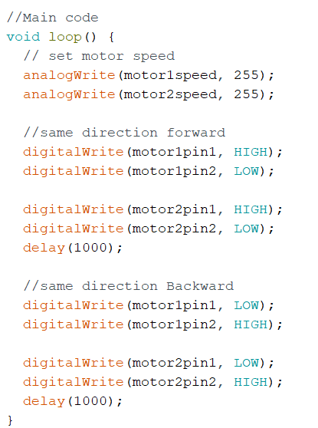
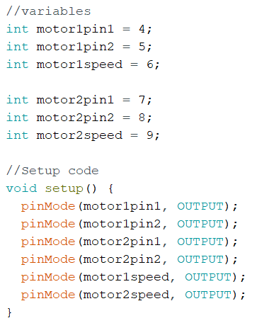
Code for testing
This code is to test the motors with Arduino and drive forward and backward

Slide 7
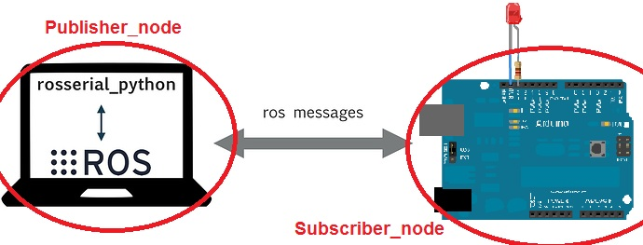
Controlling using ROSSERIAL:
For controlling the motors with raspberry PI we will have to setup ROSserial
ROSserial is a protocol that enables communication between microcontrollers (like Arduino) and ROS over serial links, facilitating the exchange of ROS messages and services.
To install rosserial on ROS noetic, type:
sudo apt-get install ros-noetic-rosserial
Clone the source code in your workspace:
git clone https://github.com/ros-drivers/rosserial.git
Then build the package using “catkin_make “

Slide 8
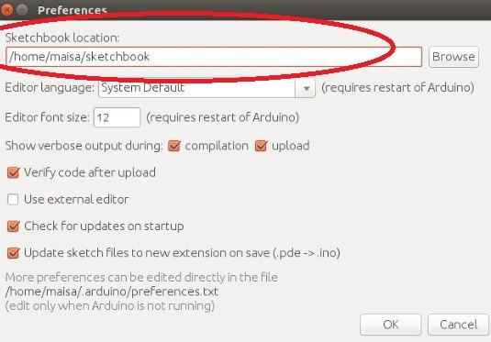
Setup ros_lib into Arduino IDE
For Arduino to be able to communicate with ROS, ros_lib must be installed. The next steps will guide you through this.
In your Arduino environment go to file-> preferences. For sketchbook location, look for libraries folder -create it yourself in case you can’t find it –

Slide 9
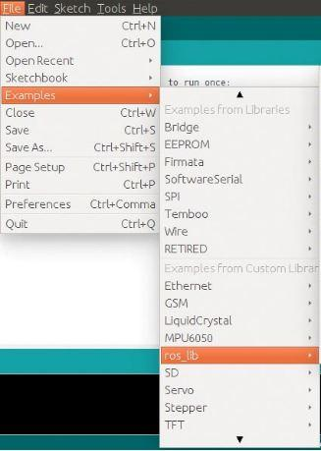
Now, in the terminal, type:
roscore
In a new terminal, use rosrun command to generate ros_lib:
rosrun rosserial_arduino make_library.py
You can see ros_lib included in your custom libraries list

Slide 10
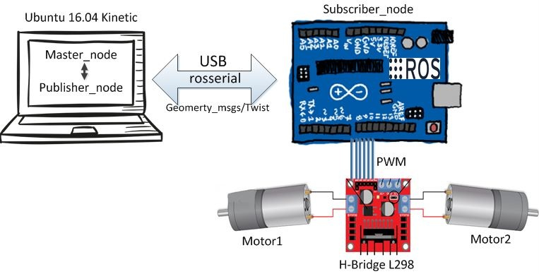
Testing publisher node
You can test with the examples from ros_lib first
To run rosserial client that passes the messages from Arduino to ROS
rosrun rosserial_python serial_node.py /dev/ttyUSB

Slide 11
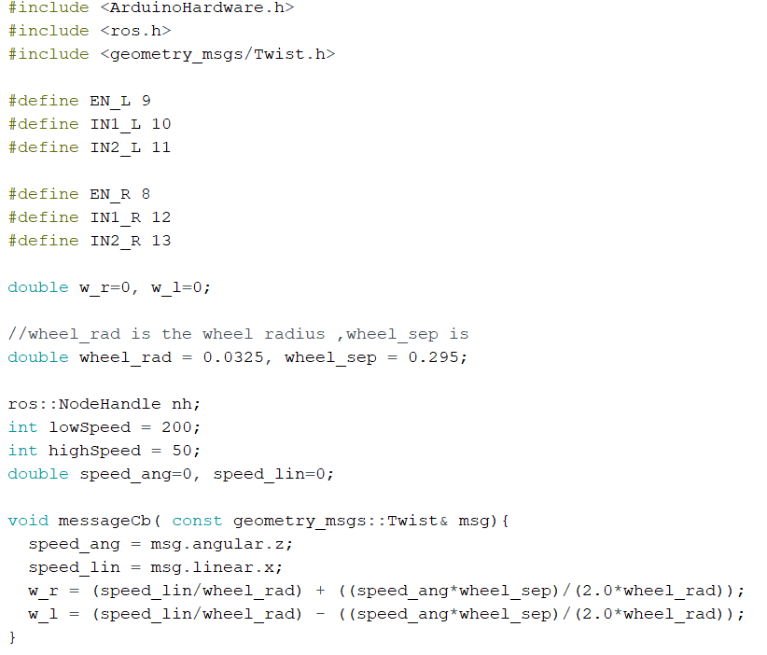
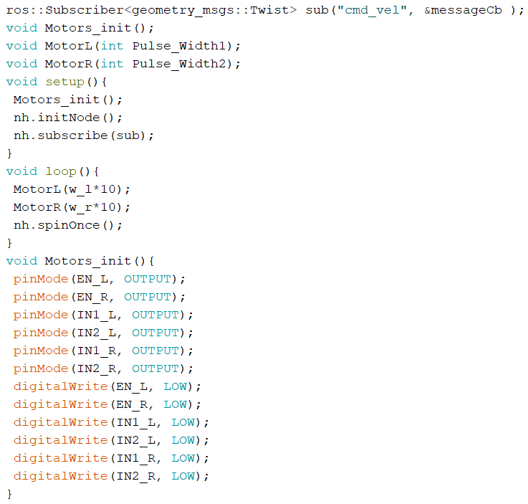
Motor code for rosserial

Slide 12
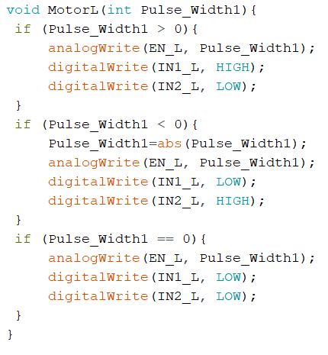
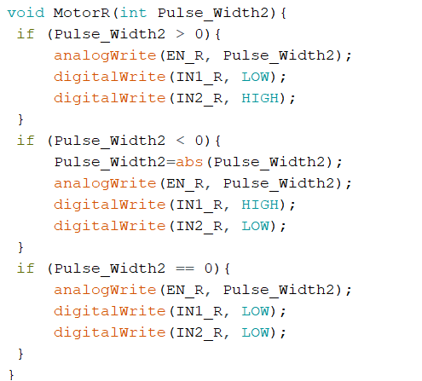
Motors functions

Slide 13
Running the node
Once the code is uploaded to Arduino, the robot can be controlled using the ROS via teleop_twist_keyboard package that enables the ROS to control the linear velocity (forward and backwards) in addition to angular velocity on the z-axis. The Twist messages via cmd_vel topic are used.
Type
Rosrun teleop_twist_keyboard teleop_twist_keyboard.py
To run rosserial client that passes the messages from Arduino to ROS
rosrun rosserial_python serial_node.py /dev/ttyUSB

Slide 14
Sensors

Slide 15
MPU6050

Slide 16
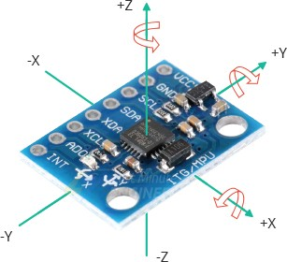
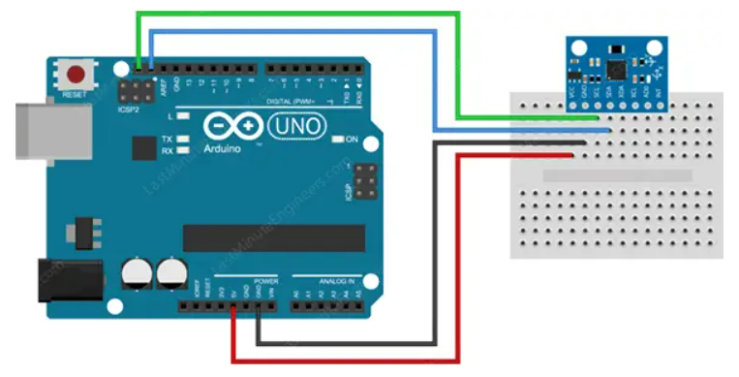
IMU setup, testing and code:
Setup:

Slide 17
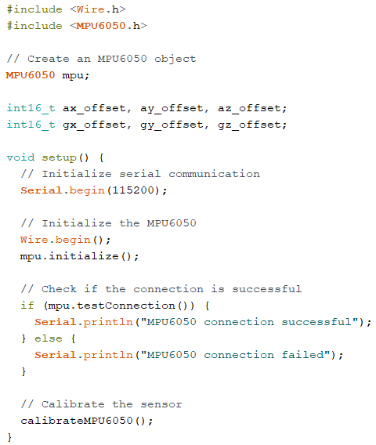
IMU code
This is the Arduino code to test the imu and make sure that the readings are within the range

Slide 18
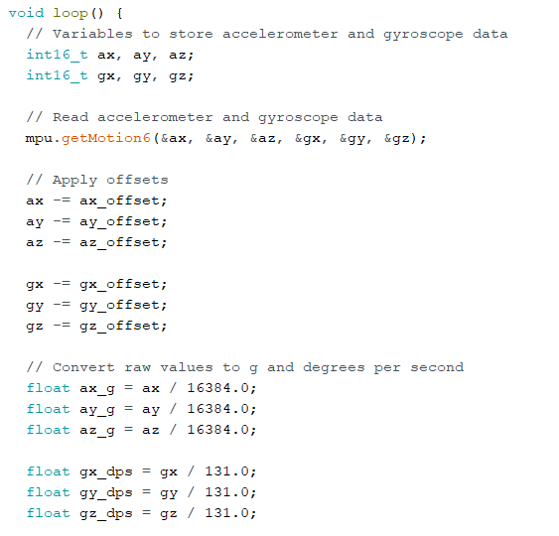
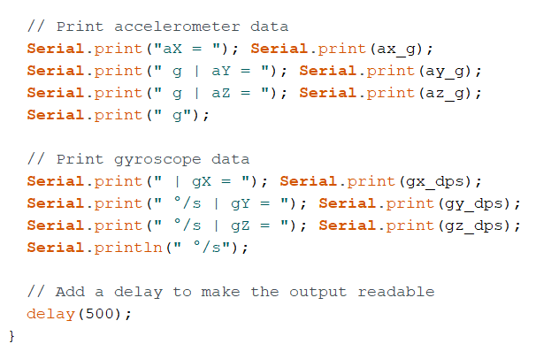
Void loop

Slide 19
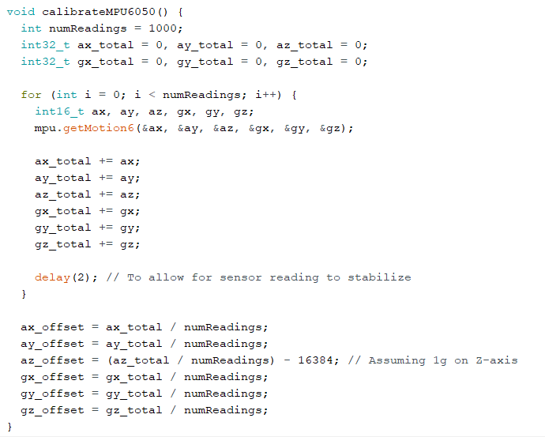
Calibration Function

Slide 20
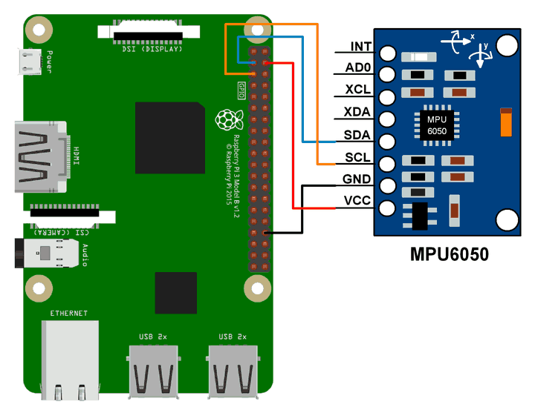
MPU6050 with Raspberry PI connection
Note: Vcc can be connected with the 3.3 volts instead

Slide 21
MPU6050_driver
Building:
The first step to build this package is install its dependency. To that, clone the i2c_device_ros package into your workspace
$ cd <YOUR_WS>/src $ git clone https://github.com/Brazilian-Institute-of-Robotics/i2c_device_ros.git
Now, clone the latest version from this repository into your catkin workspace
$ cd <YOUR_WS>/src $ git clone https://github.com/Brazilian-Institute-of-Robotics/mpu6050_driver.git $ cd ../
Then, to build the package you could use two options:
pure catkin:
$ catkin_make -DCATKIN_WHITELIST_PACKAGES="mpu6050_driver;i2c_device_ros;
catkin tool:
$ catkin build mpu6050_driver
Or just $catkin_make

Slide 22
Calibration Process
The first thing to do is run the calibration process. To run the calibration process, put the sensor on its final place on your robot (this is strongly important!) and then run the calibration node:
$ roslaunch mpu6050_driver mpu6050_calibration.launch
The process will take a few minutes to finish. While that, you can see the IMU data in the topic called "imu" and the offsets applied to MPU6050 calibration registers in the topic "imu_offsets". In a new terminal, you can see the imu messages runnig
$ rostopic echo /imu -c
and the offsets running on a new terminal
$ rostopic echo /imu_offsets –c
You'll see the angular velocity and linear acceleration values converging to zero, except for the accelerometer Z axis which the value will converge to gravity aceleration value (9,8 m/s²).
When the calibration process finish, you'll see the final offsets. For not run the calibration process all the time that you turn on your robot, pick these values and put in the offsets field in mpu_settings config file.

Slide 23
Running main node
After to calibrate the MPU sensor, you can run the main node with
$ roslaunch mpu6050_driver mpu6050_driver.launch
Config files
mpu_settings.yaml: All parameters of MPU6050 used in the calibration node and main node
Launch files
mpu6050_calibration.launch: Launch the calibration node
mpu6050_driver.launch: Launch the main node
Published Topics: /imu (sensor_msgs/IMU) Imu data with the values from MPU6050 accelerometer and gyroscope

Slide 24
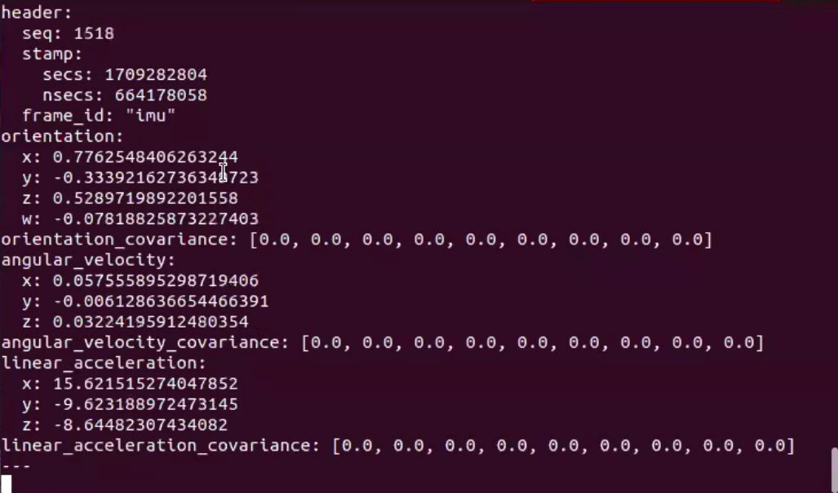
Terminal output
On master device
Rostopic list
Rostopic echo /imu/data_raw

Slide 25
Encoder

Slide 26
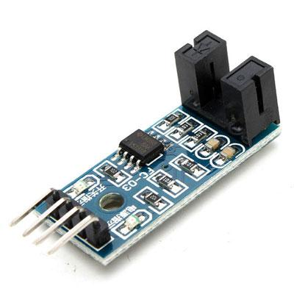
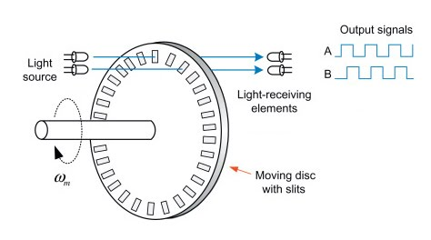
Photoelectric encoder
We are using an incremental encoder but if you are using encoder with 2 channels to indicate direction that will be better

Slide 27
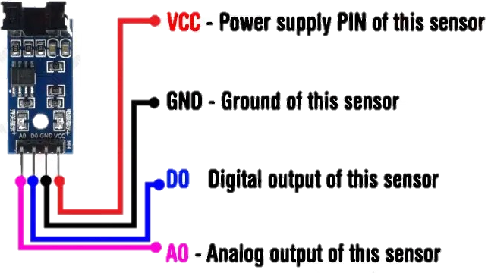
Connections:
Connecting pins of the speed module (encoder FC-03):
VCC: Module power supply from 3.3V to 12V.
GND: Ground.
D0: Digital signal of the output pulses.
A0: Analog signal of the output pulses. Output signal in real time. (Usually not used).

Slide 28
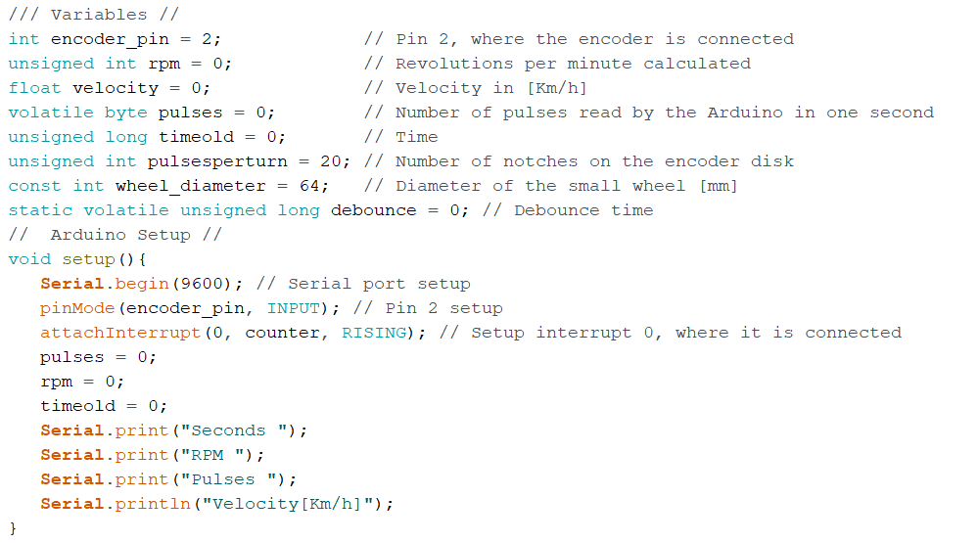
Testing code with Arduino:

Slide 29
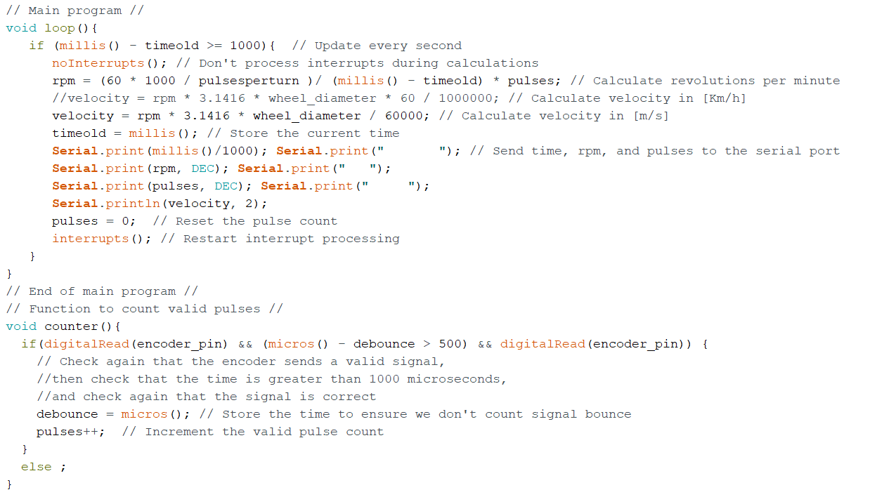
Main loop

Slide 30
Encoder with Raspberry PI
After testing with Arduino we want to test with raspberry pi to send the readings
We want to edit Arduino code to publish ticks
Then publish ticks on a topic with rosserial to raspberry pi

Slide 31
Arduino code:
This code must be setup for the Arduino to publish the ticks
Code can be found in this link:
https://automaticaddison.com/how-to-publish-wheel-encoder-tick-data-using-ros-and-arduino/

Slide 32
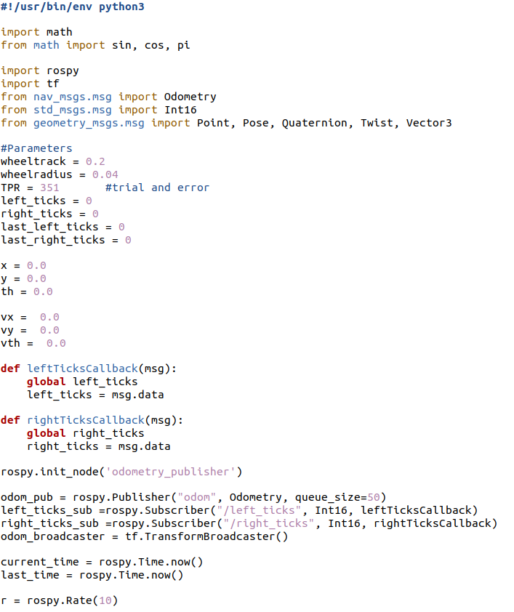
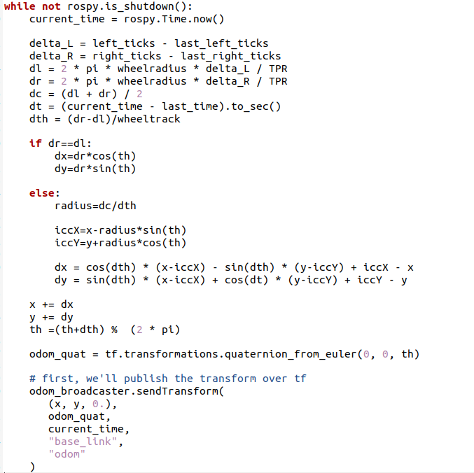
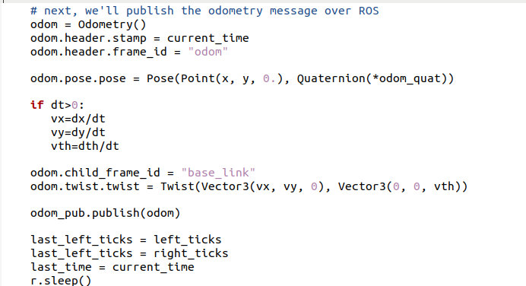
ROS node:
This node is on raspberry pi to receive the readings

Slide 33
Running node
Here ROSserial is already set up
We just have to start rosserial node:
rosrun rosserial_python serial_node.py /dev/ttyUSB
In another terminal run encoder python node
rosrun <workspace_name> encoder_node.py

Slide 34
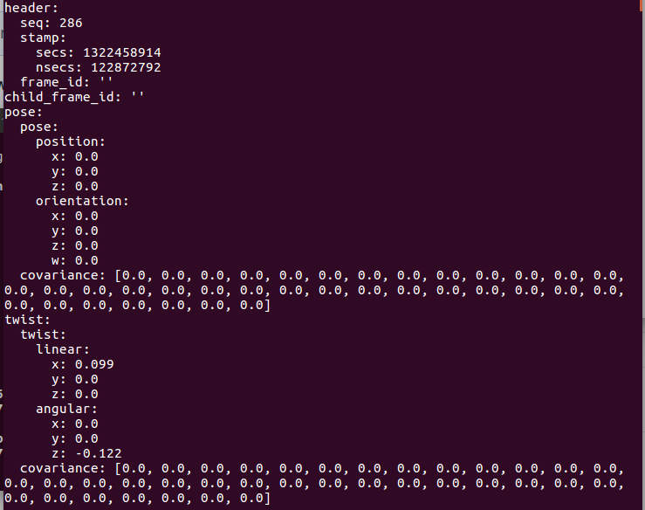
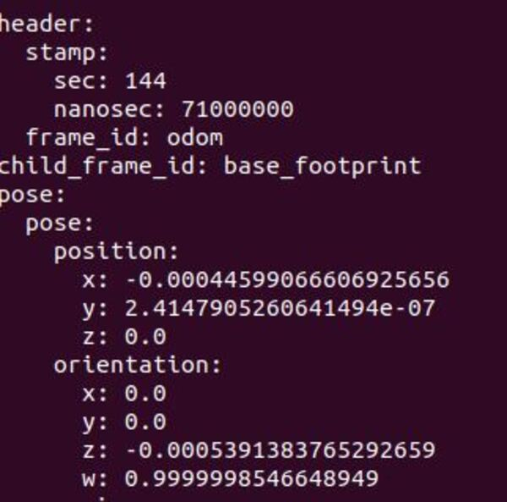
Terminal message output

Slide 35
Motors and encoders code
We will integrate Arduino code of motors and encoders together and upload it on Arduino
Then run rosserial and monitor the topics published
Run teleop and try to control the motors
If faced the error “waiting for something to subscribe to cmd_vel topic” just close the serial and initiate it again

Slide 36
Sensor Fusion using EKF
https://automaticaddison.com/sensor-fusion-using-the-ros-robot-pose-ekf-package/

Slide 37
Install the robot_pose_ekf Package
Open a new terminal window, and type:
sudo apt-get install ros-noetic-robot-pose-ekf
Now move to your workspace.
cd ~/catkin_ws
Build the package.
catkin_make

Slide 38
Add the the robot_pose_ekf node to a ROS Launch File
<!-- Extended Kalman Filter from robot_pose_ekf Node-->
<!-- Subscribe: /odom, /imu_data, /vo -->
<!-- Publish: /robot_pose_ekf/odom_combined -->
<remap from="odom" to="odom_data_quat" />
<remap from="imu_data" to="imu/data" />
<node pkg="robot_pose_ekf" type="robot_pose_ekf" name="robot_pose_ekf">
<param name="output_frame" value="odom"/>
<param name="base_footprint_frame" value="base_footprint"/>
<param name="freq" value="30.0"/>
<param name="sensor_timeout" value="1.0"/>
<param name="odom_used" value="true"/>
<param name="imu_used" value="true"/>
<param name="vo_used" value="false"/>
<param name="gps_used" value="false"/>
<param name="debug" value="false"/>
<param name="self_diagnose" value="false"/>
</node>

Slide 39
RPLidar

Slide 40
Lidar Testing with linux
https://www.youtube.com/watch?v=XyGZpgFQKAo
mkdir -p ~/rp_ws/src
cd ~/rp_ws/src
git clone https://github.com/Slamtec/rplidar_ros
cd ../
catkin_make
source devel/setup.bash
catkin_make rplidarNode
ls -la /dev | grep ttyUSB
sudo chmod 666 /dev/ttyUSB0
roslaunch rplidar_ros view_rplidar_a1.launch

Slide 41
Integration
We will make a launch file to launch all these nodes together with no effort
First make sure you made a package for your robot in your workspace:
Step 1: Create a New ROS Package
cd ~/catkin_ws/src
Mkdir my_robot_package
Step 2: Create the Encoder Node
cd my_robot_package
mkdir scripts
nano scripts/encoder_node.py 🡺 write the node code here
Save and close the file (Ctrl+O, Enter, Ctrl+X in nano).
chmod +x scripts/encoder_node.py

Slide 42
Step 3: Create the Launch Directory and Launch File
mkdir launch
nano launch/robot.launch
Launch file content:
<launch>
<!-- Connect to Arduino using rosserial -->
<node name="rosserial_node" pkg="rosserial_python" type="serial_node.py" output="screen">
<param name="port" value="/dev/ttyACM0"/>
<param name="baud" value="115200"/>
</node>
<!-- Launch Incremental Encoder node -->
<node name="encoder_node" pkg="my_robot_package" type="encoder_node.py" output="screen">
<!-- Add any necessary parameters or remappings here -->
</node>
<!-- Launch MPU6050 node with filter -->
<include file="$(find mpu6050_driver)/launch/mpu6050_driver_with_filter.launch" />
<!-- Launch RPLIDAR node -->
<include file="$(find rplidar_ros)/launch/rplidar_a1.launch" />
</launch>
Save and close the file (Ctrl+O, Enter, Ctrl+X in nano).

Slide 43
Step 4: Build the Package:
Navigate back to the root of your catkin workspace:
cd ~/catkin_ws
Build the workspace:
catkin_make
Source the workspace:
source devel/setup.bash
Step 5: Run the Launch File:
roslaunch my_robot_package robot.launch

Slide 44
You have to set up communication between raspberry pi and the master device
In the bashrc file in master device you should add these lines:
In the raspberry pi add these lines:

Slide 45
If you face a problem while connecting to the master and the data won’t echo on the master device you will have to disable the firewall in both the raspberry pi and the master computer
To disable firewall you can run this command on both devices:
sudo ufw disable

Slide 46
Set up navigation stack
https://automaticaddison.com/how-to-set-up-the-ros-navigation-stack-on-a-robot/

Slide 47
Set up navigation stack
First we should install navigation stack pacages on raspberry pi
Then in our package we will make a directory for parameters stored in the yaml files:
Mkdir param
Follow this link as previously done in the simulation:
http://wiki.ros.org/navigation/Tutorials/RobotSetup

Slide 48
References:
Setting up readings for navigation stack in ROS
https://automaticaddison.com/how-to-set-up-the-ros-navigation-stack-on-a-robot/
Motors:
https://www.hackster.io/ryanchan/how-to-use-the-l298n-motor-driver-b124c5
https://www.youtube.com/watch?v=Pqs-3GgWW3s
https://atadiat.com/en/e-rosserial-arduino-introduction/
IMU:
https://github.com/Brazilian-Institute-of-Robotics/mpu6050_driver/tree/master
http://rwx.io/posts/i2c-mpu-6050/
Encoder:
https://androminarobot-english.blogspot.com/2017/03/encoder-and-arduinotutorial-about-ir.html
https://electropeak.com/learn/interfacing-photoelectric-encoder-speed-sensor-with-arduino/#google_vignette
https://srituhobby.com/ir-infrared-speed-sensor-with-arduino-how-does-work-ir-speed-sensor/#google_vignette
https://automaticaddison.com/how-to-publish-wheel-encoder-tick-data-using-ros-and-arduino/
https://get-help.theconstruct.ai/t/convert-encoder-data-to-nav-msgs-odometery/24405/4
https://answers.ros.org/question/326434/how-to-compute-odometry-from-encoder-ticks/
Lidar:
https://www.youtube.com/watch?v=XyGZpgFQKAo

Slide 49
https://automaticaddison.com/how-to-set-up-the-ros-navigation-stack-on-a-robot/#Base_Controller
https://automaticaddison.com/how-to-control-a-robots-velocity-remotely-using-ros/
https://automaticaddison.com/how-to-publish-wheel-odometry-information-over-ros/
https://automaticaddison.com/how-to-publish-wheel-encoder-tick-data-using-ros-and-arduino/
https://wiki.ros.org/robot_pose_ekf

Slide 50
Codes
Codes are available here:
https://github.com/mariam1378/Autonomous-mobile-robot/

